Slide 1

DISEASE PREDICTION
SYSTEM
GROUP MEMBERS:-
Aditya Raj - 180410383 (ECE)
Ayush Kumar - 180410519 (ECE)
Biraj Kumar - 180410522 (ECE)
Newton Raj - 180410393 (ECE)
Sagar Kumar - 180410527 (ECE)
Devendra Kr - 180110265 (EIE)
UNDER GUIDANCE OF:-
Mr. Parijat Roy

Slide 2
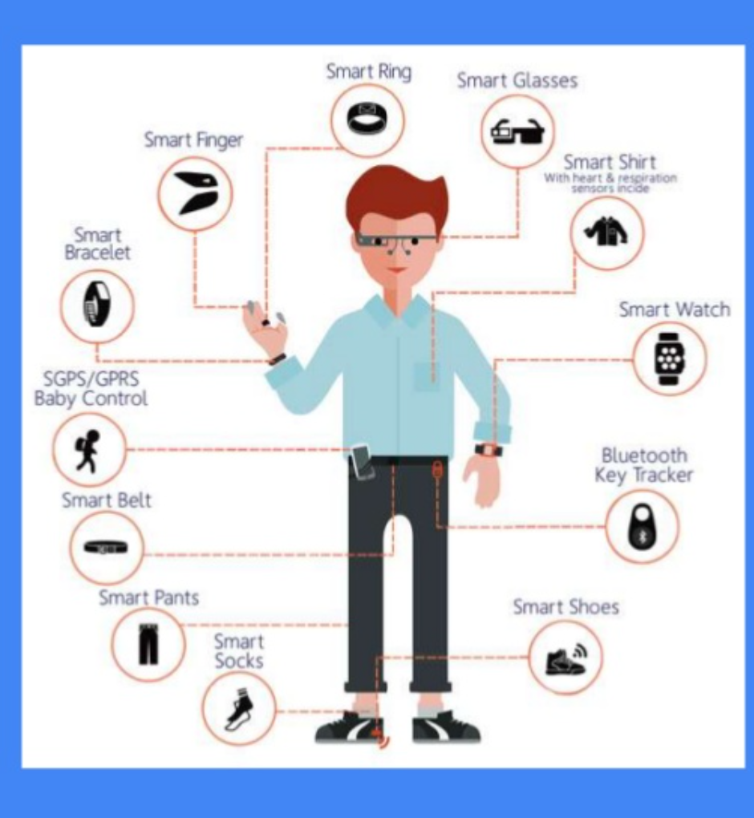
Problem Definition :-
Predict disease based on the symptoms in order to improve medical attention given to the patients.
Can be used in the absence of doctors.
With the development of big data analytics technology, accurate analysis of medical data can give benefit for early disease detection.
It is possible to save millions of lives through disease prediction using machine learning algorithms and neural network.

Slide 3
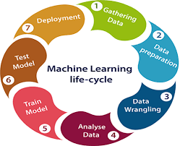
Resource/dataset :-
Kaggle data set for disease prediction from symptoms :-
https://www.kaggle.com/kaushil268/disease-prediction-using-machine-learning
Data set contains 132 columns as symptoms and 1 column as prognosis.
Data set contains 4962 rows.
Present in the form of sparse matrix.

Slide 4
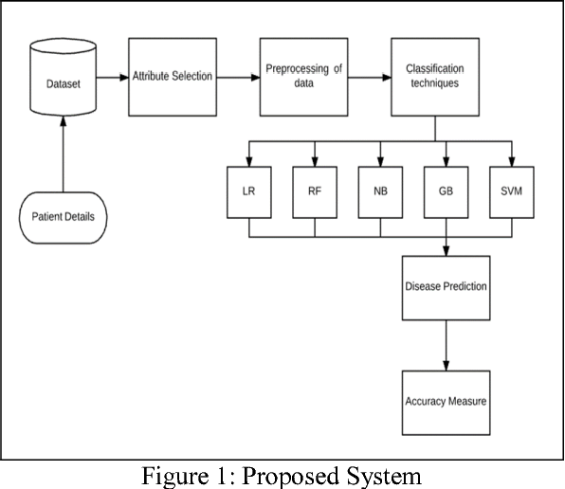
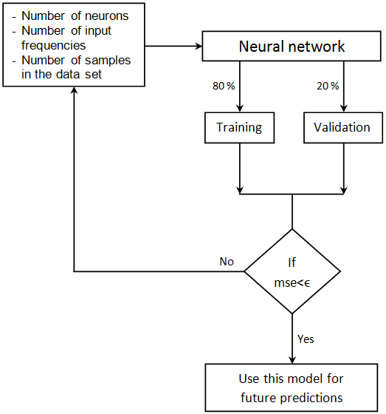
Working :-

Slide 5
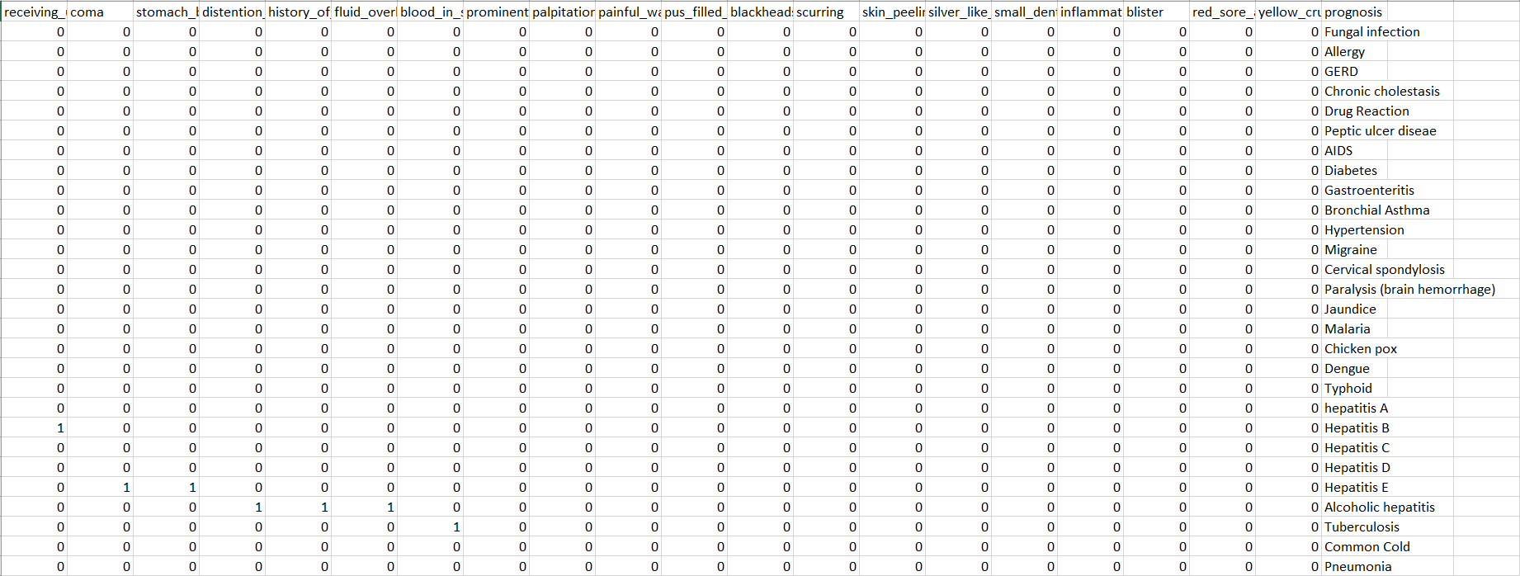

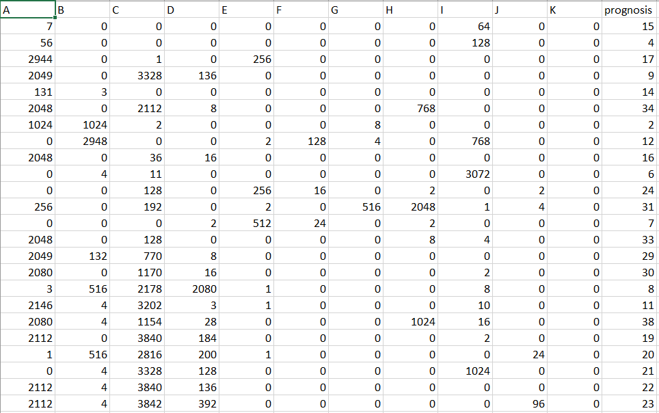
Data Pre-processing :-
Dataset present in the form of sparse matrix with 132 columns, so we grouped each 12 features as 1 features.

Slide 6
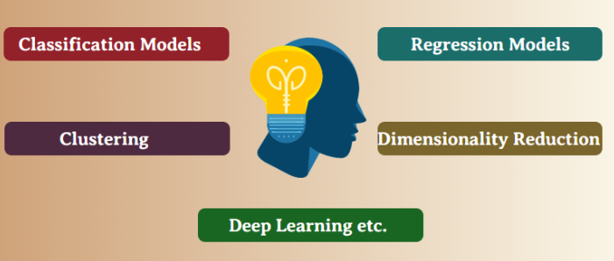
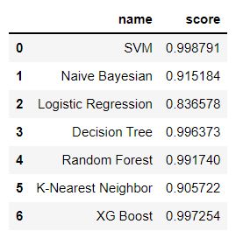
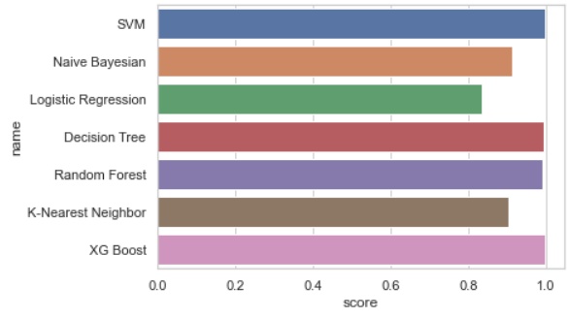

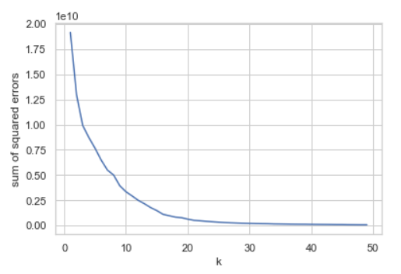
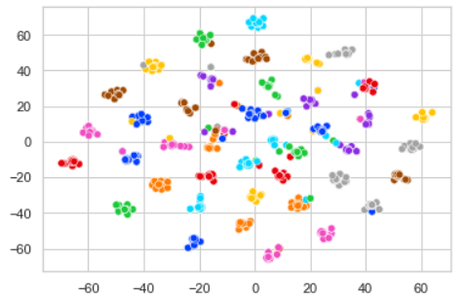
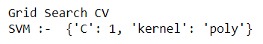
Overall Methodology :-

Slide 7
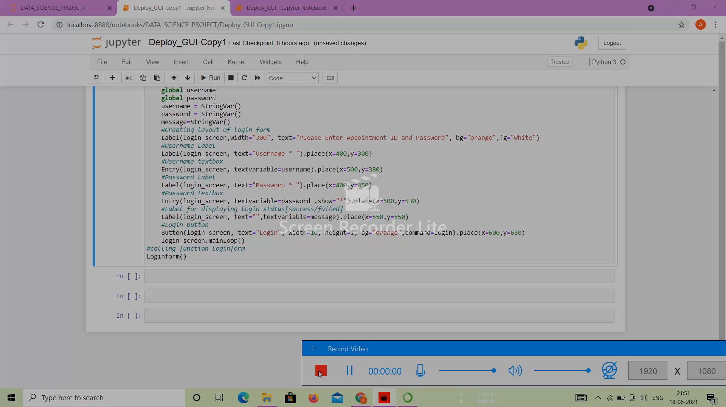
Deploy using GUI :-

Slide 8
Conclusion and future work:-
THIS TYPE OF MODEL CAN BE VERY EFFECTIVE AND CAN HELP MANY TO AVOID THE EMERGENCY SITUATION
TAKING FORWARD THIS PROJECT, WE CAN ALSO BUILD A WEBSITE WITH USEFUL ADDED FEATURES.
HISTORY GRAPH, CAN BE USED TO SHOW IMPROVEMENT IN PATIENT HEALTH CONDITION.
AUTO MAIL SENDING OPTION TO FIX THE APPOINTMENT WITH CONCERNED CONSULTANT.

Slide 9
Thank you very much!
Q & A

